Slide 1
Paris & Madrid Trip
Fred Lynn Middle School

Slide 2
189 days and counting

Slide 3
Payments
.
· Please keep track of your payments
· Those families that are on the manual must have payment paid in full or switch over to automatic payment by February 28, 2020.
Those families on the automatic plan have 30 before the trip to have balance paid.

Slide 4
Passports
· Please refer to separate handout for more detailed information.
· Fill out forms online and print to bring
· Make appointment online
· Take photo before
appointment
· Fees: $80 application fee and $35 acceptance fee
· 2 forms of identification and copies of each.
· Guardian with custody
· 2-10 weeks to process

Slide 5
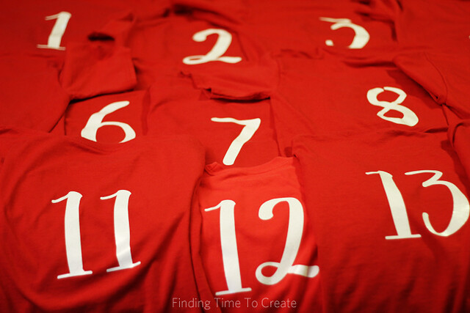
Traveling Shirts
Each student will receive a numbered t-shirt that they wear on travel days.
Please give your t-shirt size to Mr. Annunziata.

Slide 6
Roommates
· Start thinking about who you would like to room with.
· Four same gender students per room with two queen size beds.

Slide 7
Cellphone Plans
Verizon & ATandT- $10 a day travel pass
Tmobile- 3 plans $30-43 a line
Boost- 10c a text $10 per month add on 200 minutes
Sprint- $15 a month add on
Cricket- does not offer international roaming

Slide 8
Currency Exchange
· Before your trip, exchange money at your bank or credit union.
· After you’re home, see if your bank or credit union will buy back the foreign currency.
Some banks charge low or no foreign transaction fees or offer international ATM fee reimbursements.

Slide 9
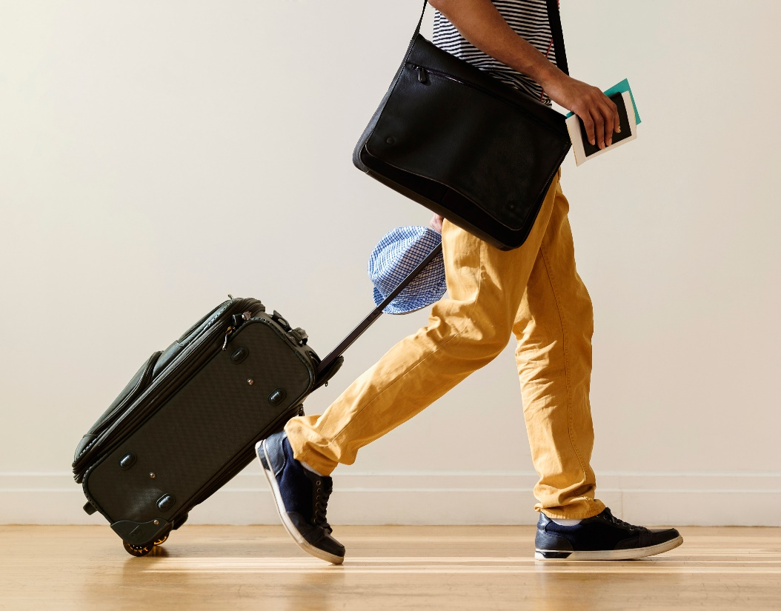
Suitcase Size
You should check with your airline first, but most domestic airlines permit a carry-on piece of luggage that is 45 linear (total) inches. A common sized bag for carry-on luggage is 22"x 14"x 9". Most airlines have a carry-on weight limit of 40 pounds.
Please weight luggage before trip and leave space/weight for souvenirs
Checked Bag Fee: $25- $100 depending on size and weight restrictions for airline.

Slide 10
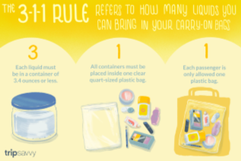
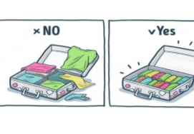
How to pack

Slide 11
Next Meeting
February 20th
7:00 p.m.
(Following the PTSO Meeting):

Slide 12
Questions?

